Slide 1
LAST WEEK WORK analysis :
Trained yolo model from scratch with default parameters for 500 epochs, but ran only for 150 epochs due to no improvement

Slide 2
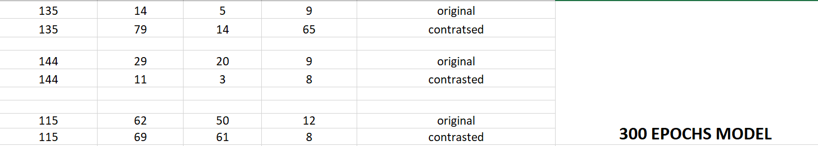
HAND VEINS MODEL
Next we trained 150 epochs as a pre trained model for 300 epochs

Slide 3
TRAINED MODEL WITH CHANGED PARAMETERS for 300 epochs but it ran for 146 epochs
 | default | changed
Initial learning rate | 0.1 | 0.001 | leads to stable convergence and less fluctuations in validation losses
Weight decay | 0 | 0.5 | for regularization, prevents overfitting
degrees | 0 | 15
scale | 0.5 | 0.7
dropout | 0 | 0.3

Slide 4
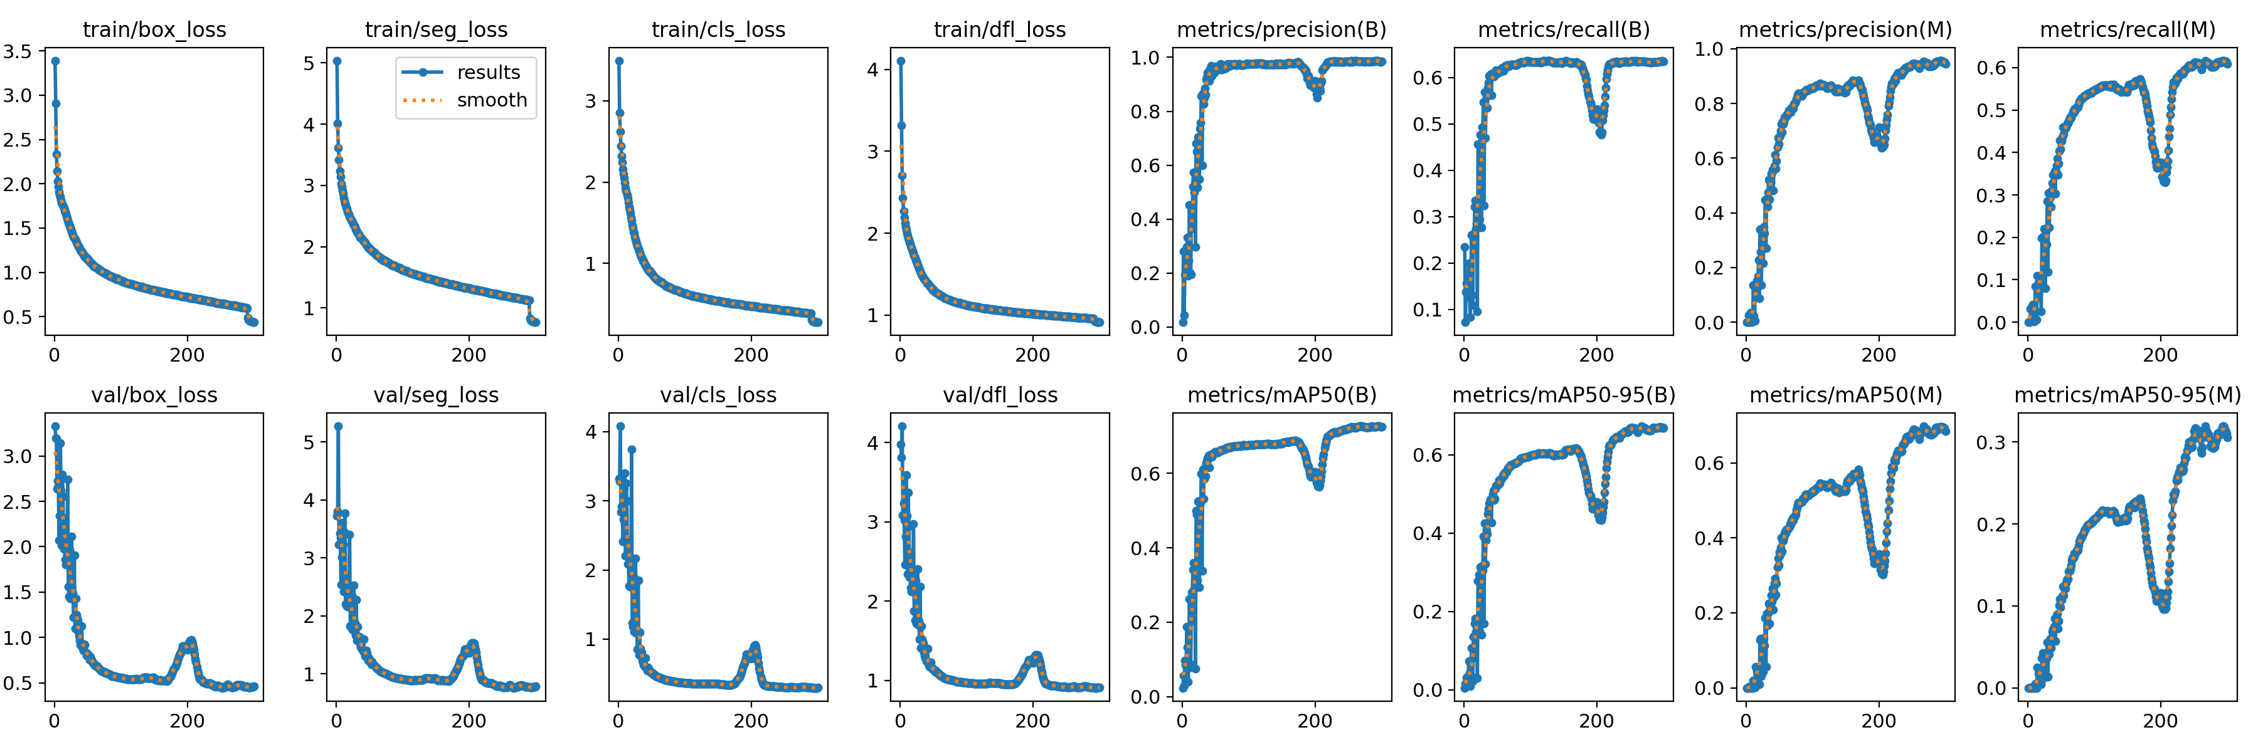
In all training models, it is overfitting
Validation error is increasing
Not able to generalize well to unseen data
Possible reasons :
Decreased contrast

Slide 5
WITH JUGULAR VEINS DATASET
PRESENT AND FUTURE WORK :
We tested the best model we got till now for jugular veins and took images with perfect segmentation.
Also added manually annotated images to it.
Converted to binary mask image
Did data augmentation for large dataset
Did horizontal, vertical, perspective and rotated image by 10 degrees
Either do pre-processing for images
Training the model from scratch with jugular vein images

Slide 6
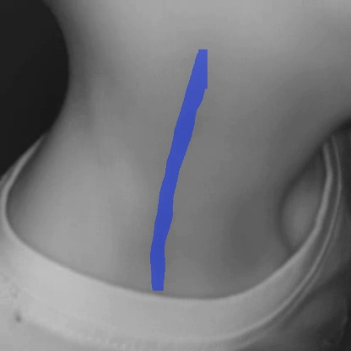
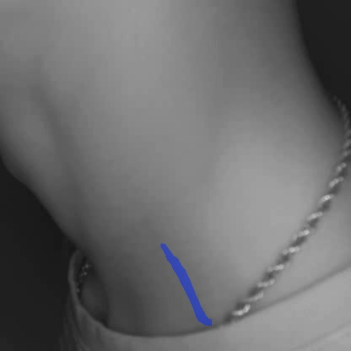
PREDICTED IMAGES

Slide 7
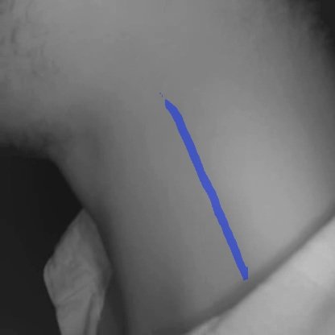
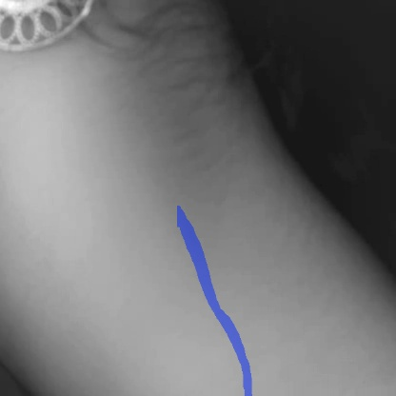
PREDICTED IMAGES

